Slide 1
Chart crimes
PN4106 · Week 7
Notes:
Real figures from news, politics, tech and science. For each one, ask: what does one mark on this chart represent, and does the picture match the numbers?

Slide 2
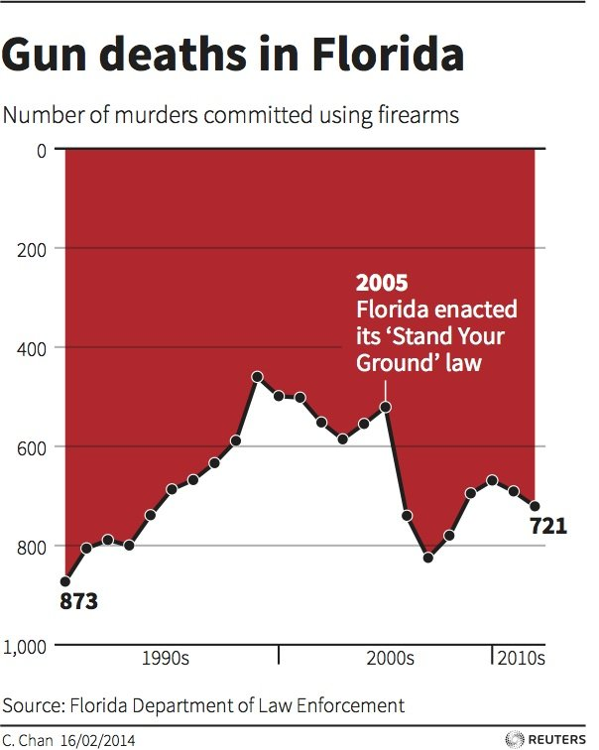
Which way is up?
Reuters, 2014. Discussed in Live Science: https://www.livescience.com/45083-misleading-gun-death-chart.html
Notes:
Florida Department of Law Enforcement data on murders committed with firearms. The y-axis runs from 0 at the top to 1,000 at the bottom, and the area is filled from the top. Most readers see the red falling after the 2005 ‘Stand Your Ground’ law and read it as deaths going down. In fact firearm murders rose from 521 (2005) to 825 (2007). The designer, Christine Chan, said she preferred to ‘show deaths in negative terms (inverted)’. Point: readers bring conventions (up = more) to every chart. Breaking a convention needs a very good reason.

Slide 3
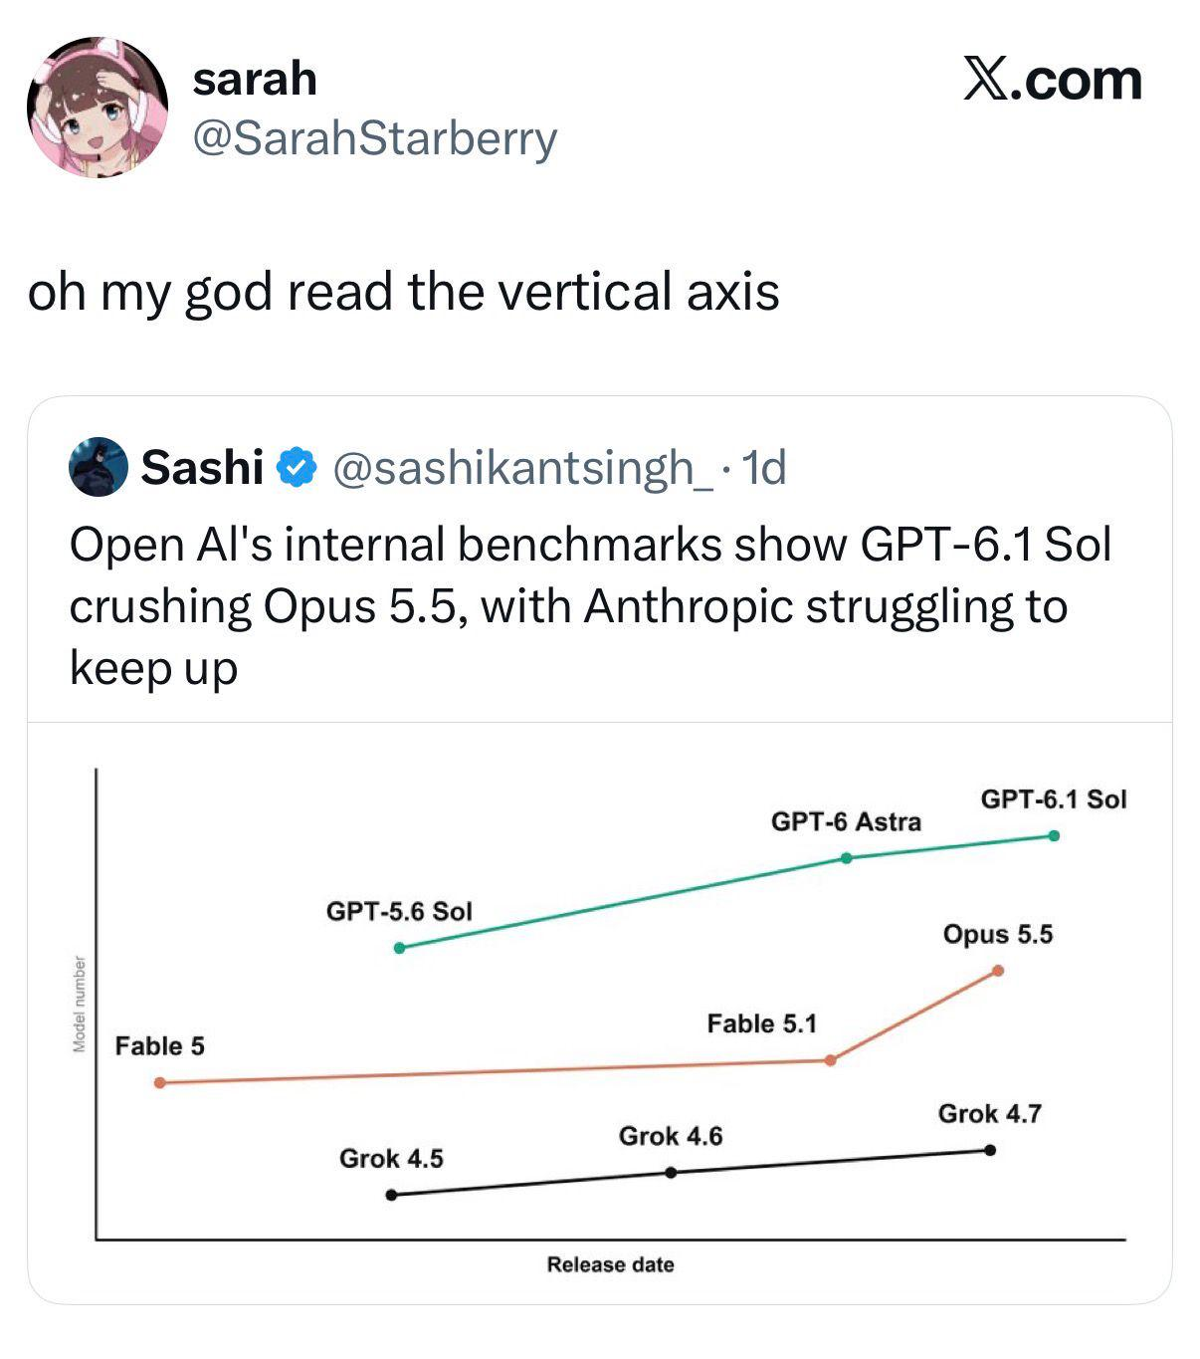
Check the Y axis
Source: [add] https://
Notes:
Version numbers are names chosen by a company, not measurements. The gap between 3 and 4 need not equal the gap between 4 and 5, and many models have names that are not numbers at all (GPT-4o, o1, o3). Ask: what are the units on this axis? What does one point measure?

Slide 4
Check the Y axis
Source: [add] https://
Notes:
Version numbers are names chosen by a company, not measurements. The gap between 3 and 4 need not equal the gap between 4 and 5, and many models have names that are not numbers at all (GPT-4o, o1, o3). Ask: what are the units on this axis? What does one point measure?

Slide 5
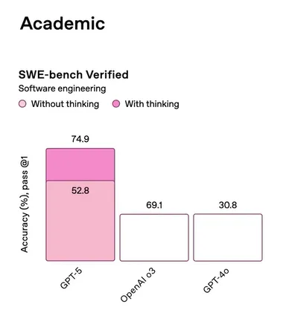
Bars that don’t match
OpenAI launch, 7 August 2025. Reported by Gigazine: https://gigazine.net/gsc_news/en/20250808-gpt-5-vibechart
Notes:
In the launch chart, GPT-5 (without thinking) scored 52.8% but its bar was drawn taller than o3’s 69.1%, and o3’s 69.1% bar was the same height as GPT-4o’s 30.8%. Hand-drawn bars that ignore the numbers. A chart made in code from the data cannot make this mistake.

Slide 6
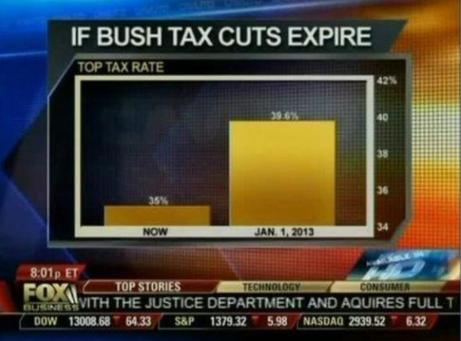
Where does the axis start?
39.6%
35%
Fox Business, 2012. Media Matters: https://www.mediamatters.org/fox-business/dishonest-fox-chart-bush-tax-cut-edition
Notes:
Top tax rate 35% now vs 39.6% from January 2013. The y-axis starts at 34%, so the second bar looks about five times taller for a 4.6 percentage-point change. A bar shows an amount by its length, so bars must start at zero.

Slide 7
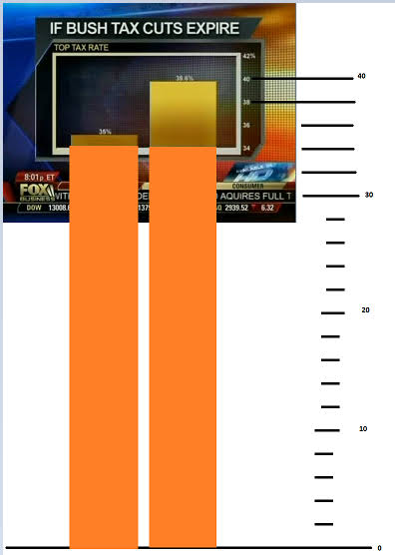
Where does the axis start?
Fox Business, 2012. Media Matters: https://www.mediamatters.org/fox-business/dishonest-fox-chart-bush-tax-cut-edition
Notes:
Top tax rate 35% now vs 39.6% from January 2013. The y-axis starts at 34%, so the second bar looks about five times taller for a 4.6 percentage-point change. A bar shows an amount by its length, so bars must start at zero.

Slide 8
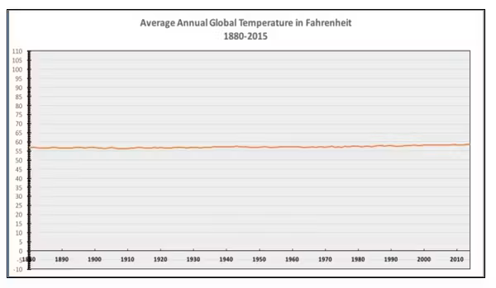
…and when zero is the wrong choice
National Review on Twitter, December 2015. Union of Concerned Scientists: https://blog.ucs.org/michael-halpern/how-to-misrepresent-global-warming-in-one-graph-for-dummies/
Notes:
Average global temperature since 1880 on a y-axis from −10 to 110 °F, which makes roughly 1 °C (about 2 °F) of warming look flat. Line charts show change by position, not length, so they need not include zero. Choose a range that shows changes that matter. Compare: a fever of 39 °C looks flat on an axis that starts at 0 °C.

Slide 9
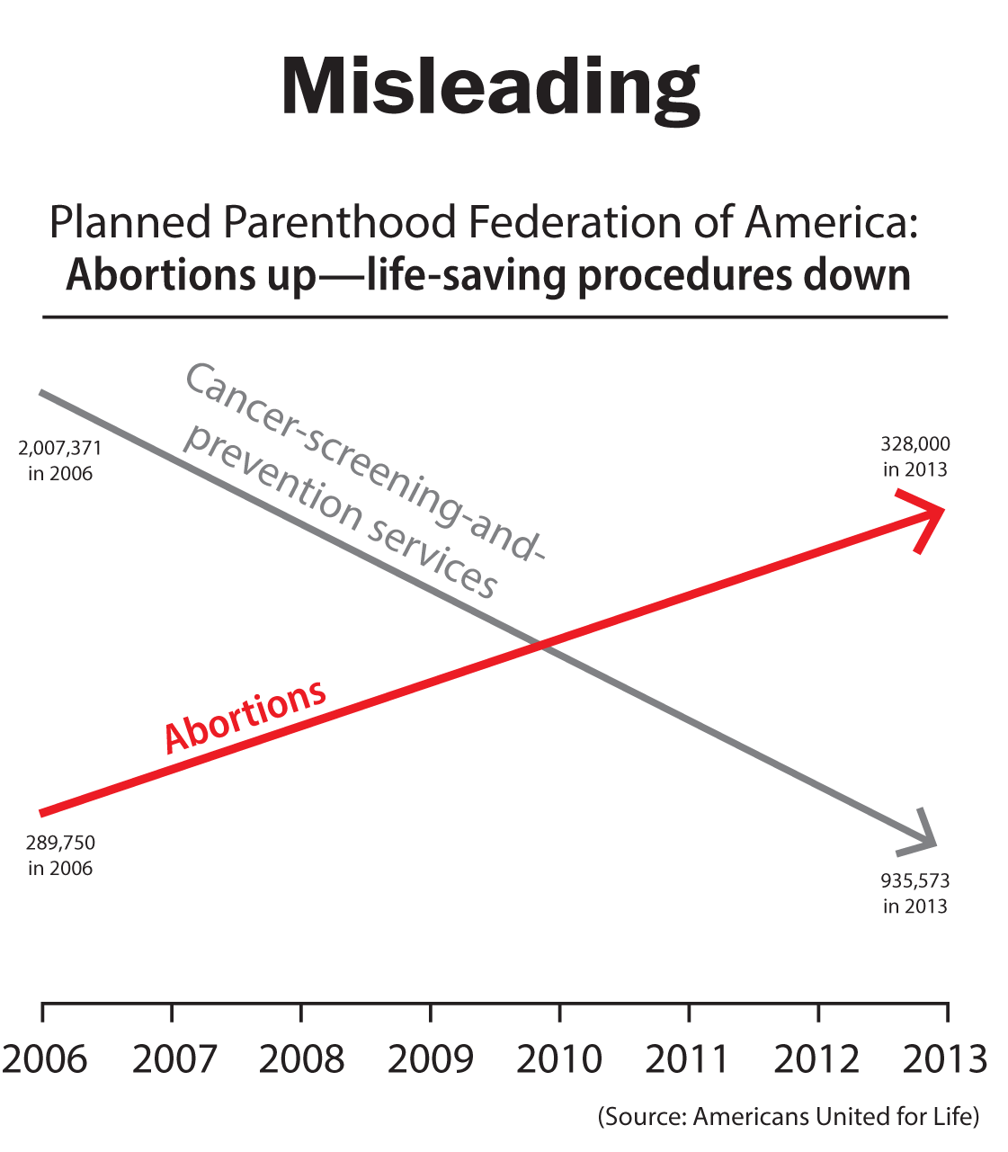
Two axes, no scales
US House Oversight Committee hearing, September 2015. Boston Globe: https://www.bostonglobe.com/news/politics/2015/12/29/the-most-misleading-chart/LVHD6M3GK8TFaHzlEc9tUJ/story.html
Notes:
Two lines, each on its own hidden scale, so they appear to cross. The numbers: cancer screening and prevention services 2,007,371 (2006) to 935,573 (2013); abortions 289,750 to 327,000. On a shared axis, the abortion line is almost flat and sits far below the other. Dual axes let the author choose where lines cross.

Slide 10
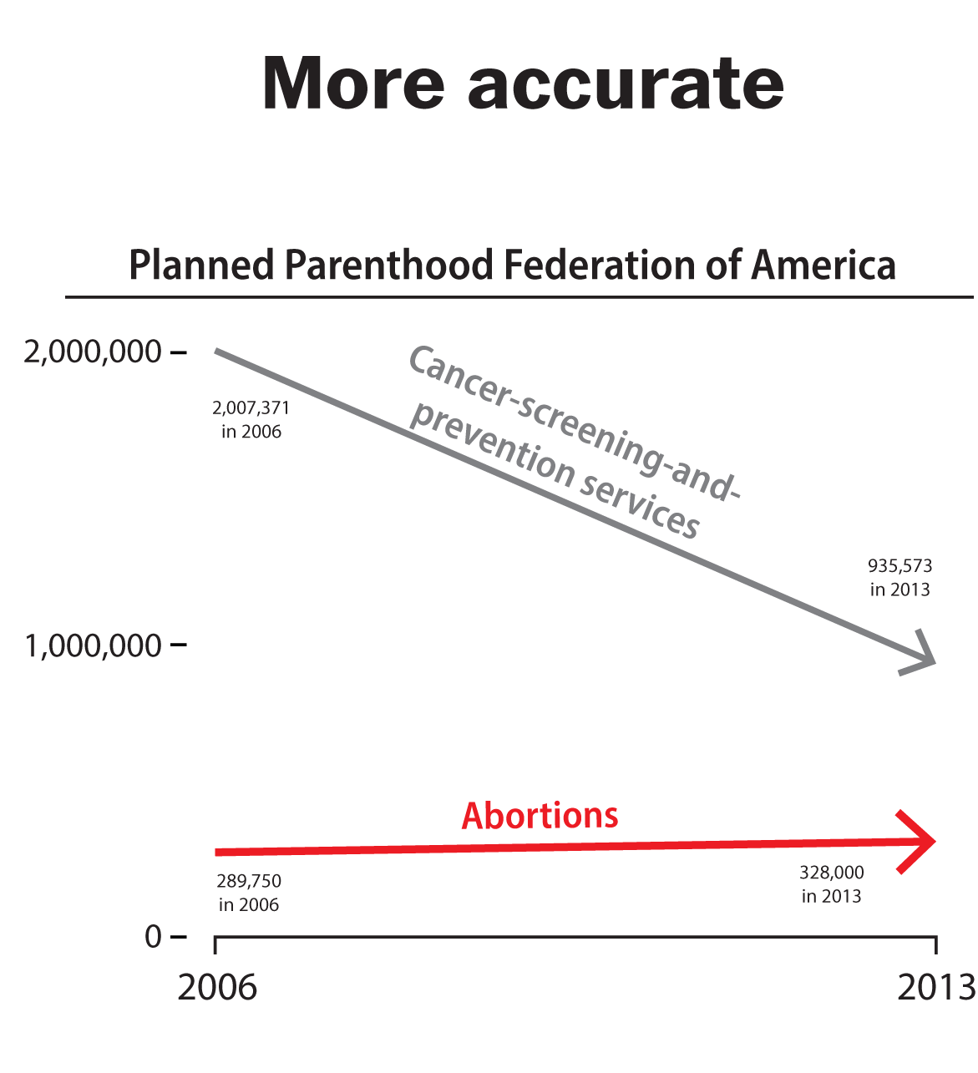
Two axes, no scales
US House Oversight Committee hearing, September 2015. Boston Globe: https://www.bostonglobe.com/news/politics/2015/12/29/the-most-misleading-chart/LVHD6M3GK8TFaHzlEc9tUJ/story.html
Notes:
Two lines, each on its own hidden scale, so they appear to cross. The numbers: cancer screening and prevention services 2,007,371 (2006) to 935,573 (2013); abortions 289,750 to 327,000. On a shared axis, the abortion line is almost flat and sits far below the other. Dual axes let the author choose where lines cross.

Slide 11
Two axes, no scales
US House Oversight Committee hearing, September 2015. Boston Globe: https://www.bostonglobe.com/news/politics/2015/12/29/the-most-misleading-chart/LVHD6M3GK8TFaHzlEc9tUJ/story.html
Notes:
Two lines, each on its own hidden scale, so they appear to cross. The numbers: cancer screening and prevention services 2,007,371 (2006) to 935,573 (2013); abortions 289,750 to 327,000. On a shared axis, the abortion line is almost flat and sits far below the other. Dual axes let the author choose where lines cross.

Slide 12
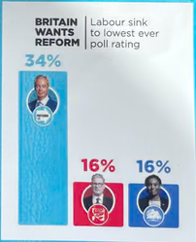
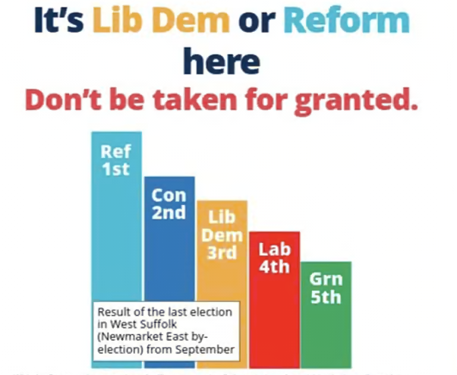
“Only we can win here”
Paste: second leaflet example
Full Fact, “Lowering the bar” (2019): https://fullfact.org/news/election-2019/lowering-the-bar
Notes:
A staple of UK election leaflets. Common tricks: bars not drawn to scale (Suffolk Coastal 2019: Labour’s 30.5% drawn at about 80% of the Conservatives’ 58.1%); results from a different election (Gateshead 2019: a Police and Crime Commissioner election with under 15% turnout, instead of the general election); candidates left out; local-council or projected results presented as if they were a general election. Ask: which election? Are the bars to scale? Who is missing?

Slide 13
“Only we can win here”
Paste: second leaflet example
32
Full Fact, “Lowering the bar” (2019): https://fullfact.org/news/election-2019/lowering-the-bar
Notes:
A staple of UK election leaflets. Common tricks: bars not drawn to scale (Suffolk Coastal 2019: Labour’s 30.5% drawn at about 80% of the Conservatives’ 58.1%); results from a different election (Gateshead 2019: a Police and Crime Commissioner election with under 15% turnout, instead of the general election); candidates left out; local-council or projected results presented as if they were a general election. Ask: which election? Are the bars to scale? Who is missing?

Slide 14
“Only we can win here”
48
Paste: second leaflet example
32
Full Fact, “Lowering the bar” (2019): https://fullfact.org/news/election-2019/lowering-the-bar
Notes:
A staple of UK election leaflets. Common tricks: bars not drawn to scale (Suffolk Coastal 2019: Labour’s 30.5% drawn at about 80% of the Conservatives’ 58.1%); results from a different election (Gateshead 2019: a Police and Crime Commissioner election with under 15% turnout, instead of the general election); candidates left out; local-council or projected results presented as if they were a general election. Ask: which election? Are the bars to scale? Who is missing?

Slide 15
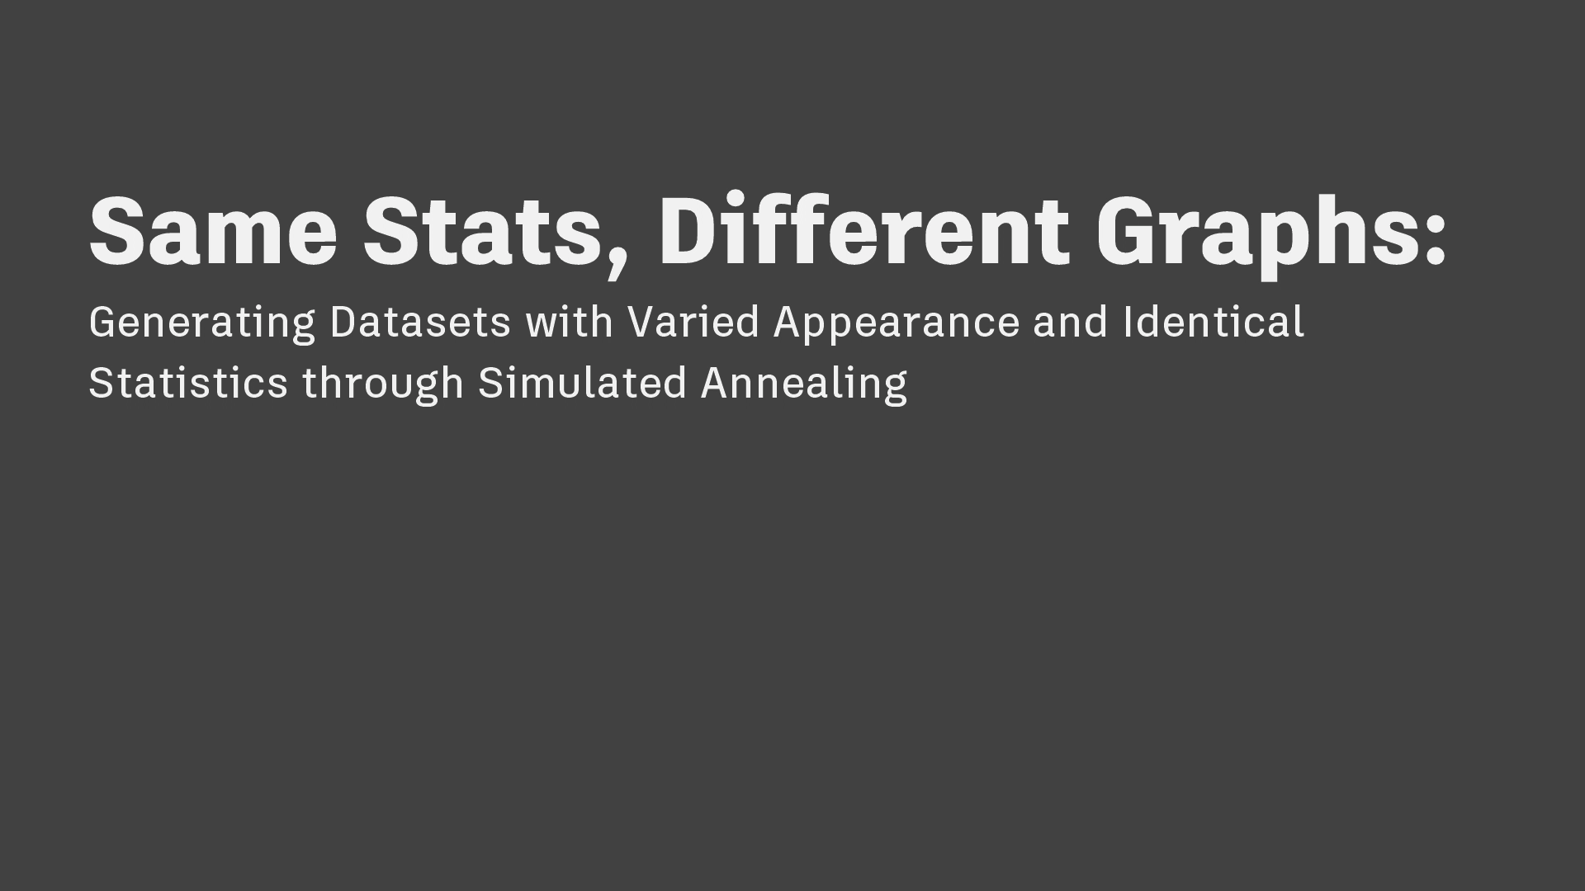
Same statistics, different pictures
Paste: Datasaurus Dozen (Matejka & Fitzmaurice, 2017)
Matejka & Fitzmaurice (2017) Same stats, different graphs. CHI 2017. https://doi.org/10.1145/3025453.3025912
Notes:
Twelve datasets with the same means, standard deviations and correlation (to two decimal places), but completely different shapes, including a dinosaur. A modern version of Anscombe’s quartet. Summary statistics can’t replace looking at the data.

Slide 16
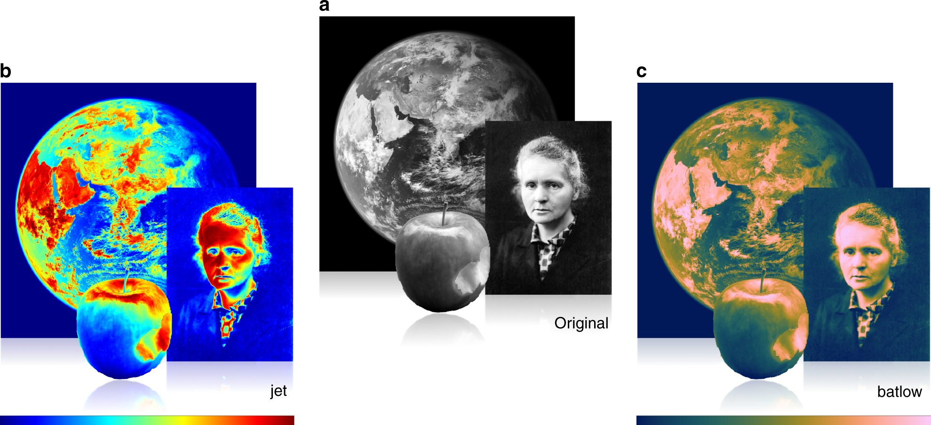
Rainbows invent boundaries
Paste: Crameri, Shephard & Heron (2020), Nature Communications, Figure 1 (CC BY)
Crameri, Shephard & Heron (2020) The misuse of colour in science communication. Nat Commun 11: 5444. https://doi.org/10.1038/s41467-020-19160-7
Notes:
Rainbow colour maps (such as jet) change lightness unevenly, so smooth data shows sharp bands that aren’t in the data, and the order of colours is hard to read. They also fail for colour-blind readers and in greyscale. Common in brain maps. Use perceptually uniform maps (viridis, cividis, batlow). Open access (CC BY).

